Slide 1
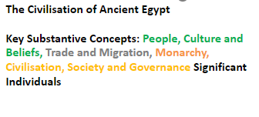
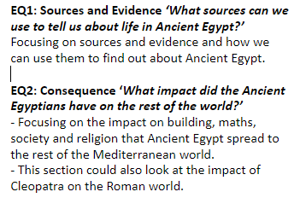
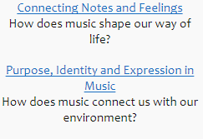
History
RE
Enquiry Question – How and why do people show their commitment through the journey of life?
Who is a Muslim and what do they believe?
PSHE
Areas of Study:
Relationships
Computing
Purple Mash
Areas of Study: Coding
Citizens of Earth
Music
Charanga

Slide 2
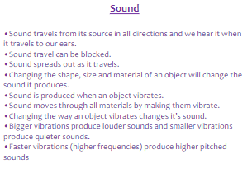
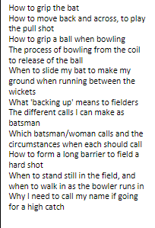
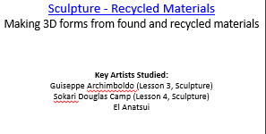
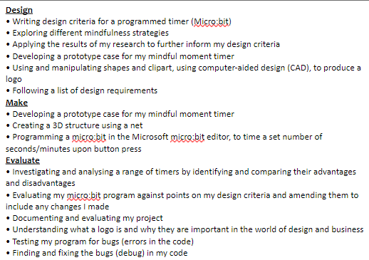
PE – Cricket
Science
Art
Design and Technology
Digital World – Mindful Moments Microbit Timer
Citizens of Earth

